Slide 1
Neural machine translation model on CNTK - GIX
MSRA

Slide 2
Description
Recently Deep Learning is really making great progresses in various AI tasks including speech recognition, image classification, text understanding.
In this project, we are going to further explore the textual deep learning model.
Among those text related model, the Sequence to Sequence model with recurrent neural network (LSTM) is the most widely used one. It is used in many scenarios and especially useful in conversation model and machine translation scenario.

Slide 3
Machine Translation
The most classic task of language understanding. Valuable for both academic and industry
  Language analysis
  Language generation
Huge commercial use, Billion dollars business
  Microsoft, Bing Translator, Skype
  Google, Google Translator
  Baidu, Facebook and tencent
  Etc.

Slide 4
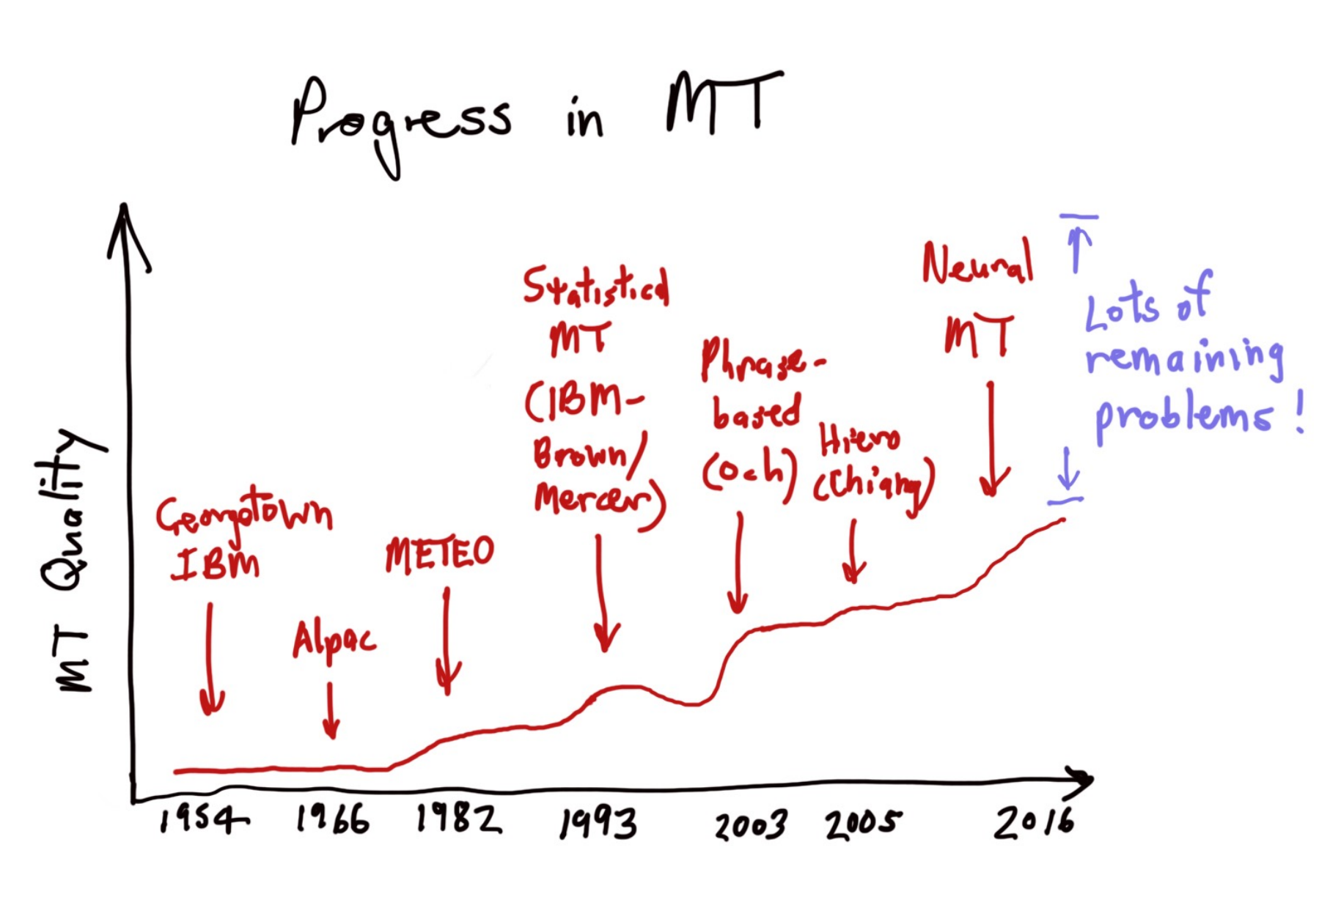
Progress of MT

Slide 5
Neural Machine Translation
1.End-to-end training
  All parameters are simultaneously optimized to minimize a loss function on the network’s output
2. Distributed representations share strength
  Better exploitation of word and phrase similarities
3. Better exploitation of context
  NMT can use a much bigger context – both source and partial target text – to translate more accurately
http://nlp.stanford.edu/projects/nmt/Luong-Cho-Manning-NMT-ACL2016

Slide 6
CNTK
Microsoft is working on building the cognitive toolkit (CNTK), one of the most powerful deep learning platform in the world. In this platform, it has provided very flexible and powerful components to build various deep learning models, such as convolutional neural network, recurrent neural network. Besides of building these basic models, another very important thing for us is leveraging these models to solve real word problems, and build interesting innovational applications.

Slide 7
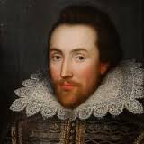
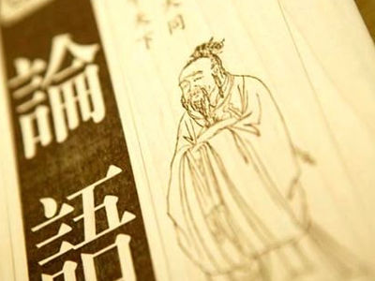
Tasks
In this project, we are going to enable the neural machine translation and related tasks on top of CNTK.
Actually machine translation isn't restrict to the translation from one language to another, it could derive other applications like converting textual information from one style to another style
(e.g. from 文言文 to 白话文, from a normal essay to Shakespear's). These scenarios could make the possible output of this project more interesting.

Slide 8
Technical requirement
with knowledge on basics of deep learning, especially on Recurrent Neural Network & LSTM.
work with C++ / Python.
With basic experience on textual data processing and mining

Slide 9
Planned time schedule
Prepare data for the task (1 week)
  Data collecting
  Data cleaning
Build NMT model for different scenario (2-3 weeks)
  Basic translation model - Chinese <-> English
  Chinese -> 文言文
  English <-> Shakespeare
Build WebApp/demo for the translator (1 week)

Slide 10
Backups
References – Chinese
神经网络机器翻译Neural Machine Translation(1): Encoder-Decoder Architecture
神经网络机器翻译Neural Machine Translation(2): Attention Mechanism
神经网络机器翻译Neural Machine Translation(3): Achieving Open Vocabulary Neural MT
神经网络机器翻译Neural Machine Translation(4): Modeling Coverage & MRT
神经网络机器翻译Neural Machine Translation(5): Gradient-based Optimization Algorithms
Introduction to Neural Machine Translation with GPUs (part 1)
Introduction to Neural Machine Translation with GPUs (Part 2)
Introduction to Neural Machine Translation with GPUs (part 3)
Papers
Ilya Sutskever, Oriol Vinyals, Quoc V. Le. 2014. Sequence to sequence learning with neural networks. Advances in Neural Information Processing Systems, 4:3104-3112.
Dzmitry Bahdanau, Kyunghyun Cho, and Yoshua Bengio. 2015. Neural machine translation by jointly learning to align and translate. In ICLR.

